Slide 2

Engagements
Managed Professional Service
3rd Party Org Name | Cat Level | Support Level | Certification Goal | Initial GAP Score (NC %) | Date Full Report Posted | Current GAP Score (NC %) | Score Change | Last Catch-Up Request Sent | Contacted | Achieved
Community Chaplaincy Norfolk | C3 | Group | IASME Gold | 82.00% | Oct-21 | 4.54% | Hugely Reduced | Were already in dialogue | Yes | No
2 Way Tenancy Solutions CIC | C4 | Group | IASME Gold | 94.74% | 25/10/2021 | 90.00% | Slight | 11/03/2022 | Yes | No
Step Together Volunteering | C4 | Group | CE+ | 85.71% | 10/05/2021 | 85.71% | No | 14/03/2022 | Yes | No
South West Community Chaplaincy Ltd | C4 | Group | CE+ | 50.00% | 20/10/2021 | 50.00% | No | 14/03/2022 | Yes | No
Sussex Pathways | C4 | Group | CE+ | 71.43% | 18/10/2021 | 71.43% | No | 14/03/2022 | Yes | No
C2C Social Action | C4 | Group | IASME Gold | 76.19% | 15/10/2021 | 76.19% | No | 14/03/2022 | Yes | No
Ameina Centre CIC | C4 | Group | IASME Gold | 57.14% | 10/12/2021 | 57.14% | No | 14/03/2022 | Yes | No
CleanSheetⁱ | C1 | Individual | ISO27001 | 0% | N/A | N/A | N/A | 17/06/2021 | Yes | Yes
Nottingham Women's Centre | C1 | Individual | IASME Gold | 72.73% | 10/04/2021 | 72.73% | No | 11/03/2022 | Yes | No
Community Led Initiatives | C4 | Group | IASME Gold | 72.72% | 10/12/2021 | 0.00% | Fully Reduced | 28/01/2022 | Yes | No
Women's Community Matters | C1 | Individual | IASME Gold | 40% | 21/10/2021 | 40% | No | 29/11/2021 | Yes | Yes
The Women's Centre Cornwall | C1 | None | IASME Gold | N/A* | N/A* | N/A | N/A | No 121 Support requested | Yes | No
Circles South West | C2 | Group | CE+ | 80.95% | 20/10/2021 | 80.95% | No | 14/03/2022 | Yes | No
BWC (Brighton Women's Centre) | C1 | Individual | IASME Gold | 68.18% | 10/04/2021 | 31.82% | Improved | 25/02/2022 | Yes | No
Circles South East | C4 | Group | CE+ | 85.00% | 19/10/2021 | 85.00% | No | No response | Yes | No
Women's Work (Derbyshire) Ltd | C1 | Individual | IASME Gold | 23.80% | 10/06/2021 | 9.52% | Hugely Reduced | 03/12/2021 | Yes | No
St Mungo's | C1 | Group | IASME Gold | N/A* |  | N/A | N/A | 14/03/2022 | Yes | No

Slide 3
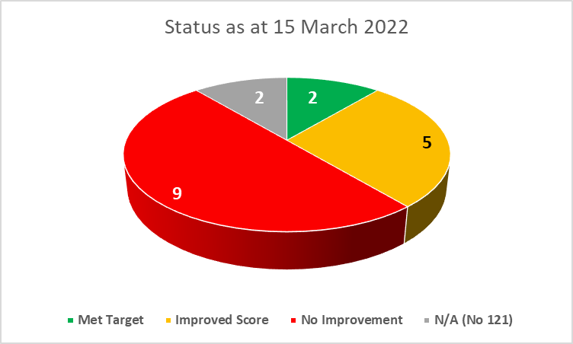
Engagement Status
Managed Professional Service

Slide 4
User definitions
Managed Professional Service
As a supplier, I need to... | So I can...
Know what the Dynamic Framework is, and whether I comply with it | Ensure I'm eligible to work with HMPPS, and operate using systems designed to cope with cyber attacks
Understand why I need cyber security certification | Ensure I'm protecting the identities of ex-offenders we support Show my commitment to cyber security, become a certified supplier and work with HMPPS
Know the difference between Cyber Essentials, Cyber Essentials Plus and IASME Gold, as well as when I need to apply for them | Decide which certification is needed, and identify the right one for my organisation
Know what the criteria is for Cyber Essentials Plus and IASME Gold, plus any deadlines | Complete my application correctly and on time
Know where I apply/register for the Cyber Essentials (Cyber Essentials Plus, IASME Gold) scheme | Become a certified supplier, work with HMPPS, support ex-offenders
Understand what each certification covers, and the steps involved in the process | Know what I'll be purchasing and prepare for each step
Understand the technical updates my IT team must introduce, plus guidance on how to do this
Know the IT policies I should introduce to my organisation, plus guidance on how to do this

Slide 5
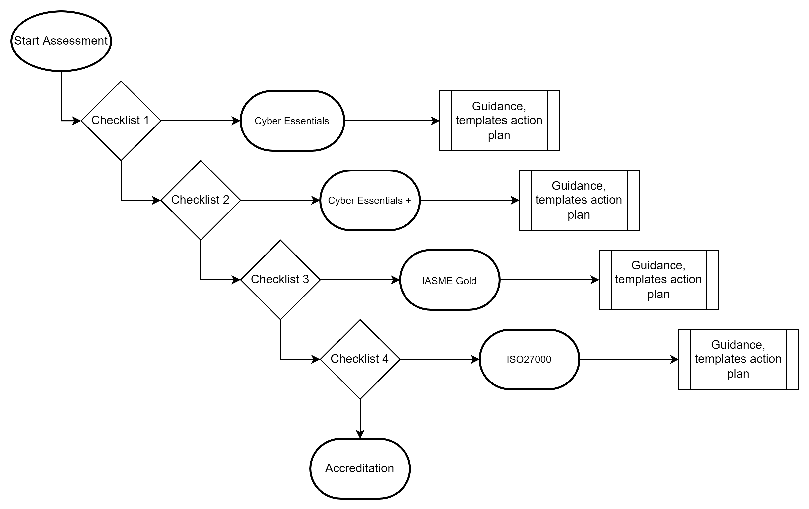
Customer Maturity Decision Workflow
Managed Professional Service

Slide 6
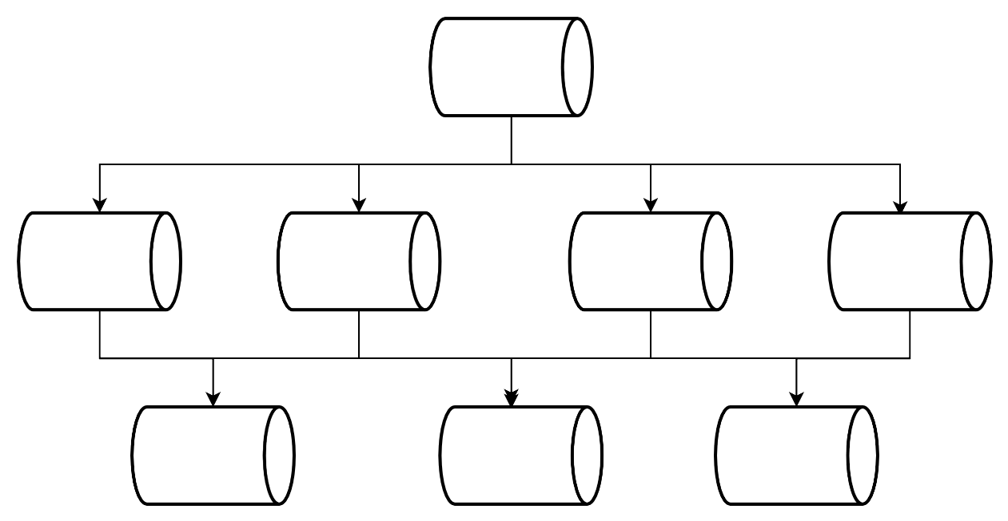
Document Structure
Managed Professional Service
Reviewing - Customer Data structure
Tidying / simplifying templates
Extranet set up
Link - https://redrockconsulting.sharepoint.com/sites/MPS_MoJ/

